Slide 1
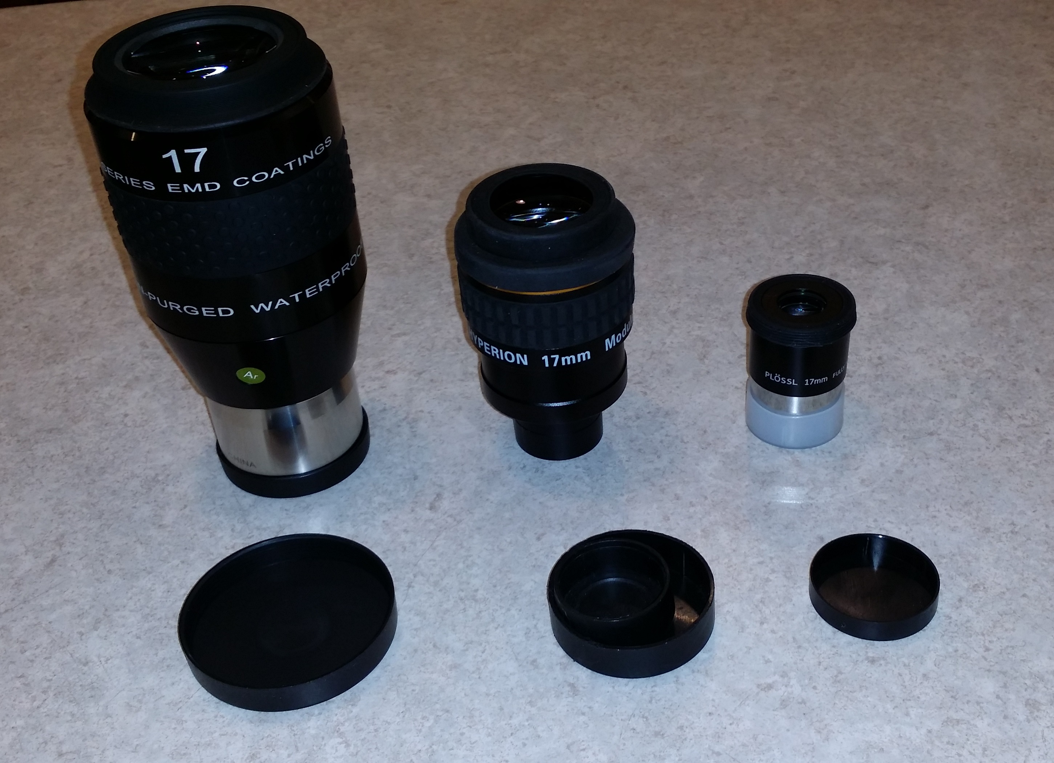
Eyepieces
Paul Surowiec

Slide 2
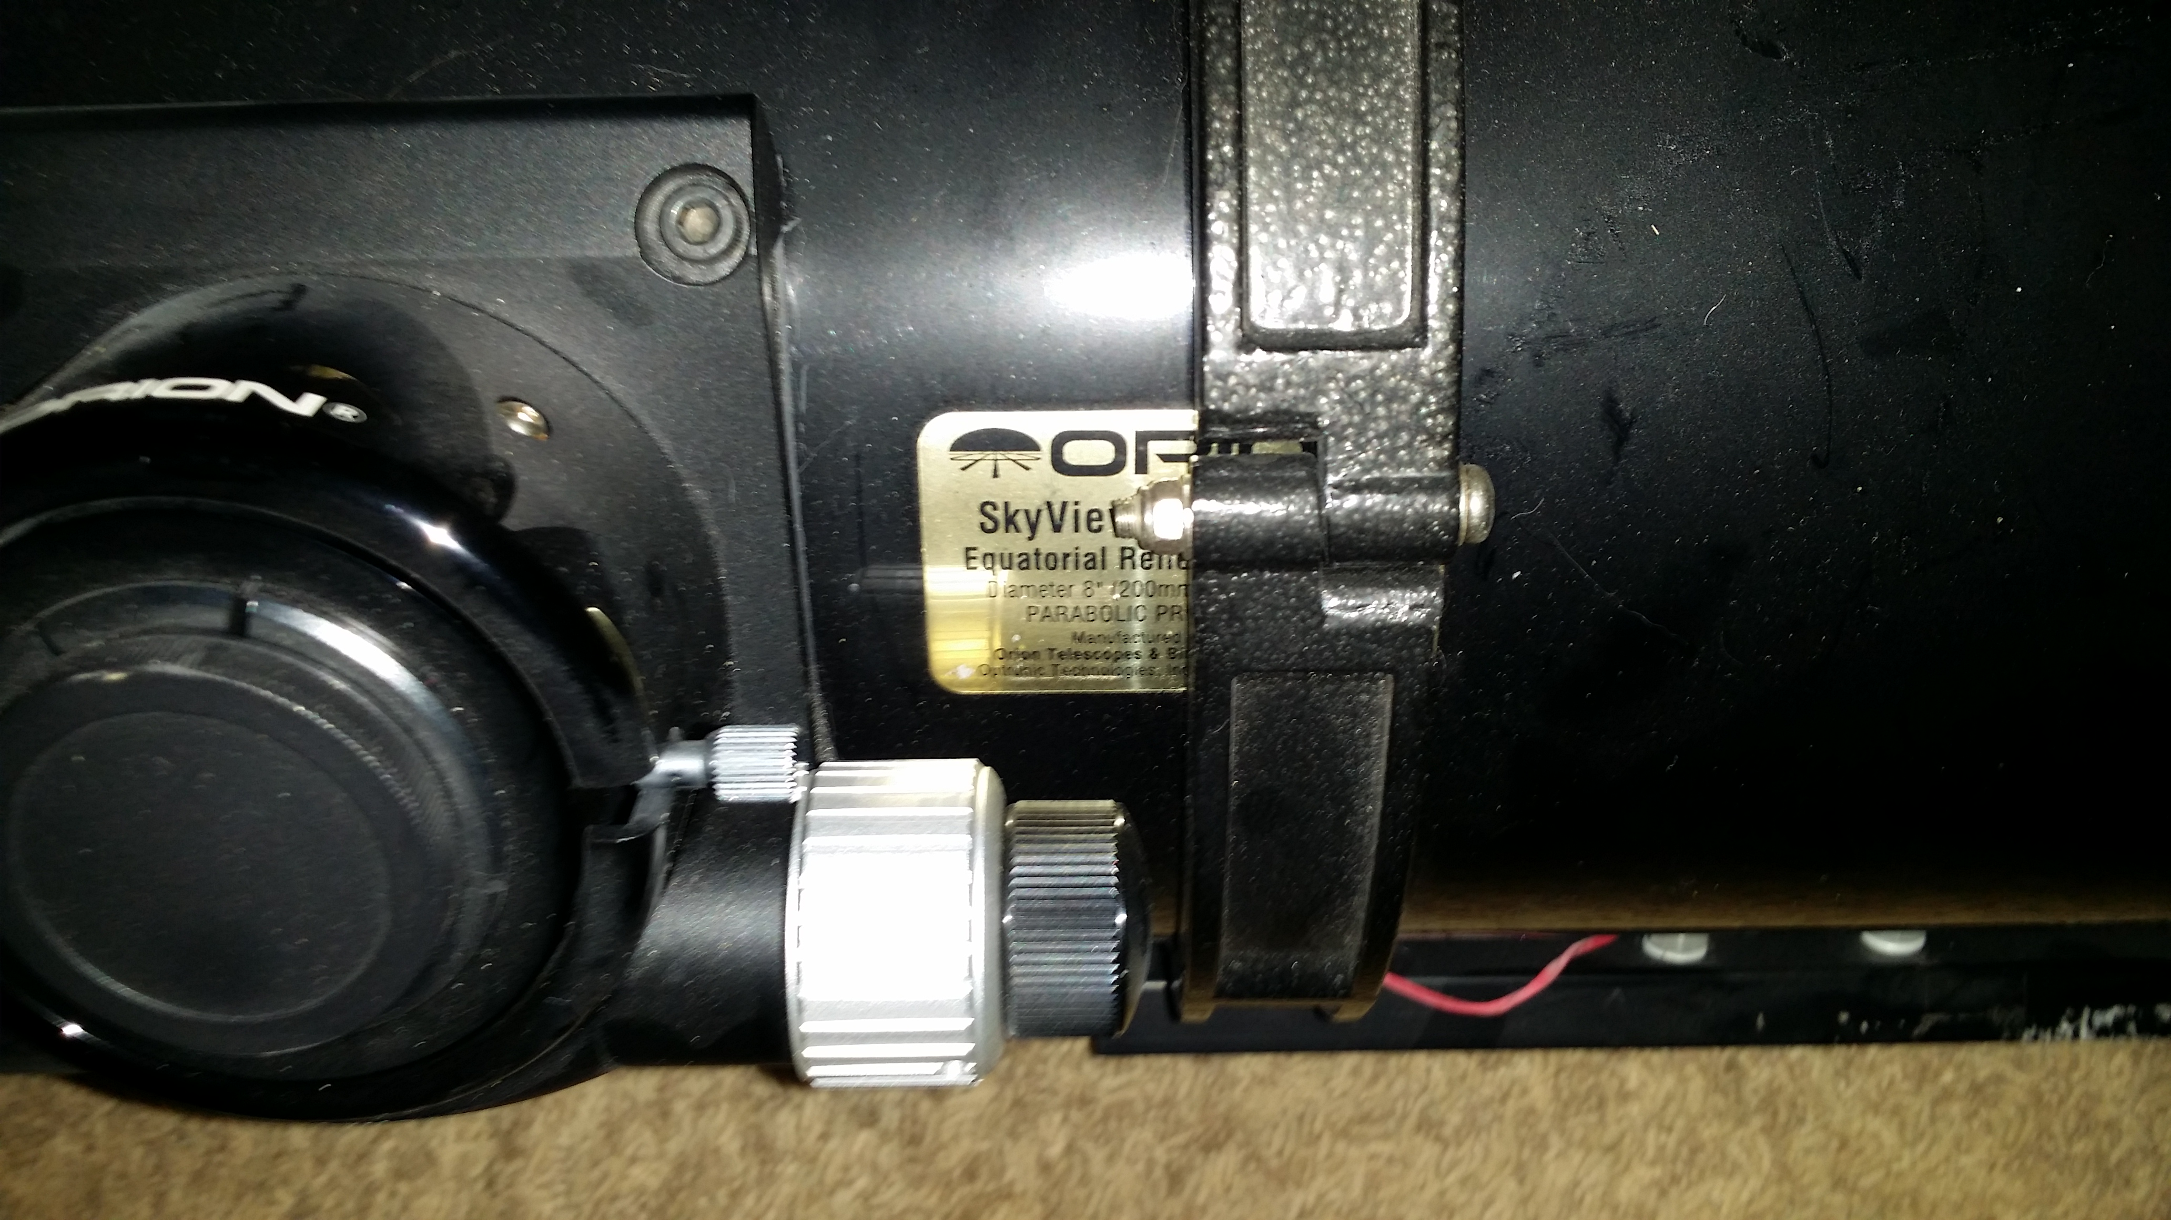
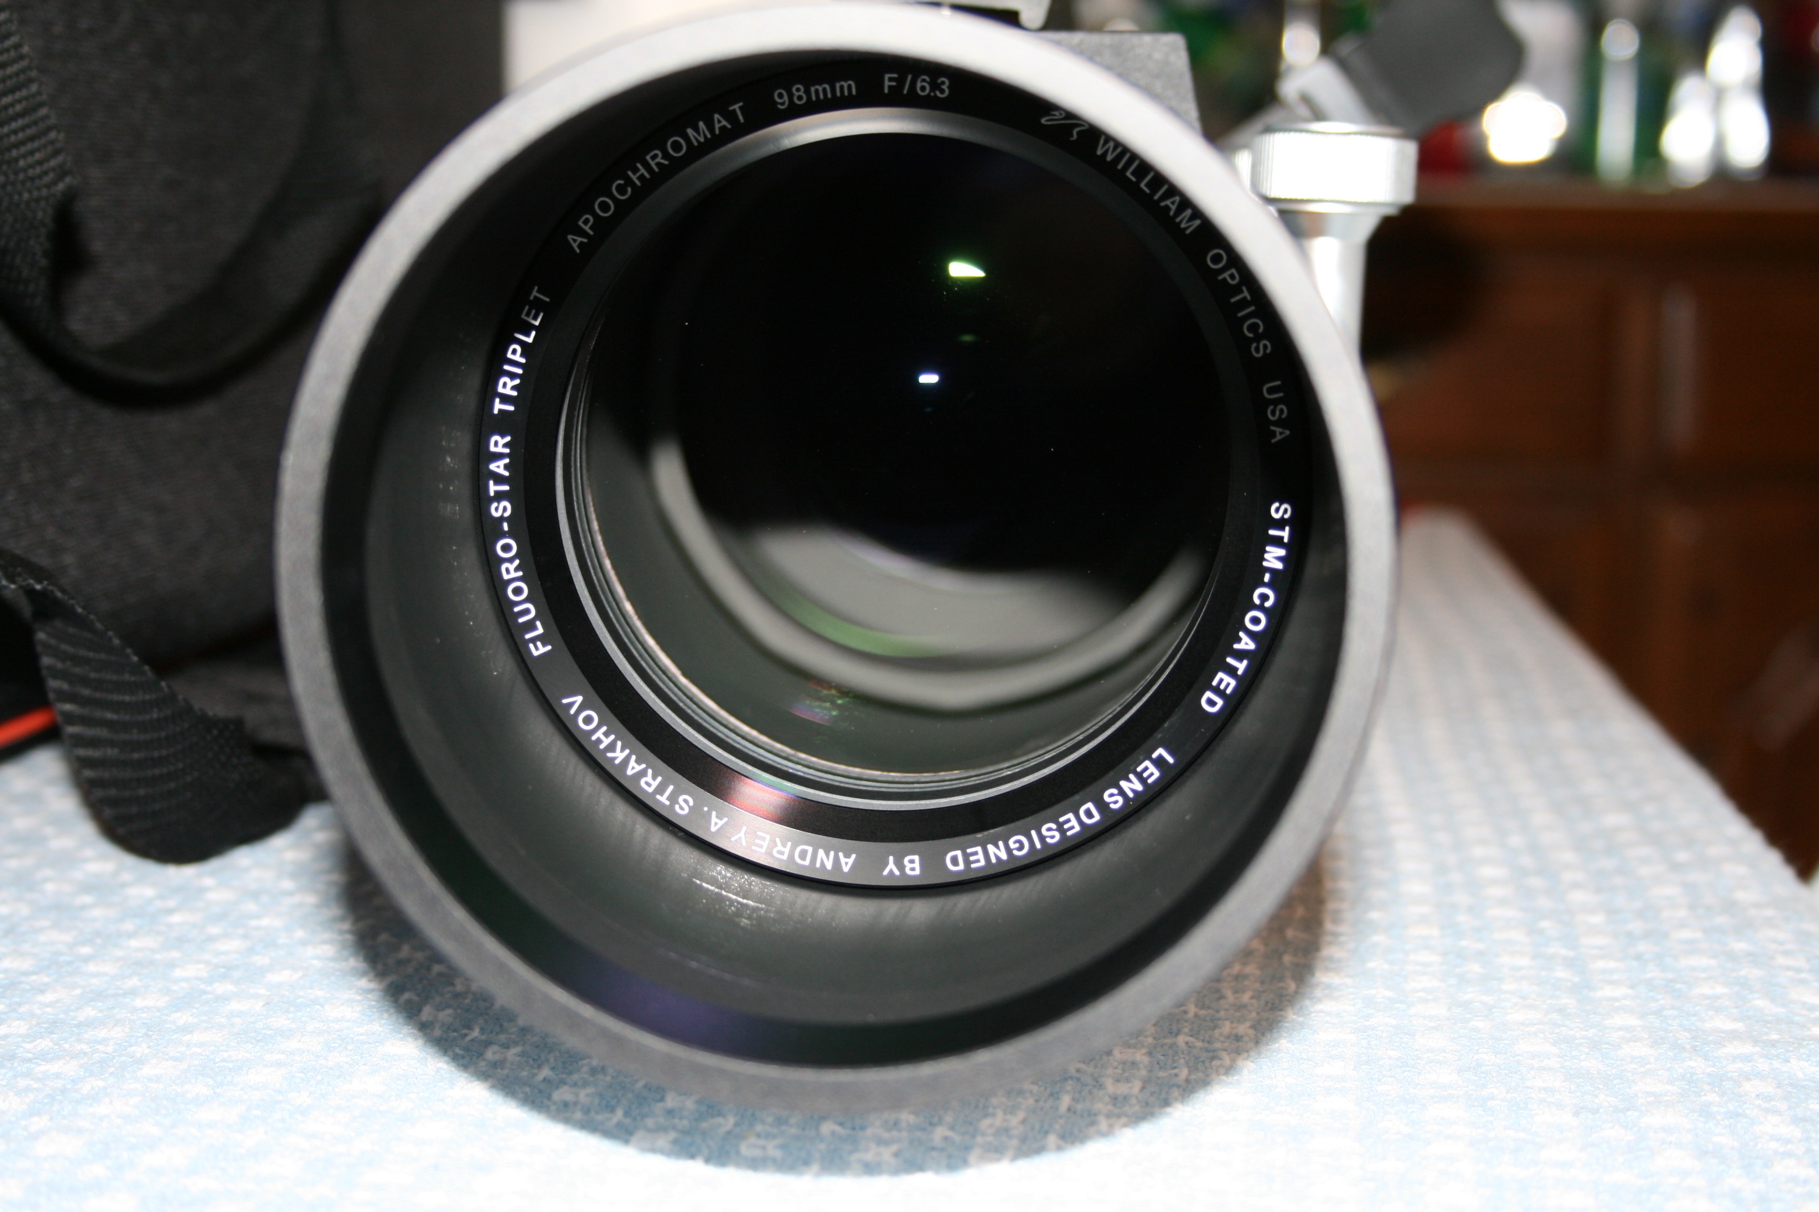
Telescope Specs.

Slide 3
Aperture X f-ratio = f or fl 98 x 6.3 = 617

Slide 4
Eyepiece Focal Length in mm
AFOV - Apparent Field of View
Note: Not present on all Eyepieces

Slide 5
Eyepiece Formulas
Magnification = Telescope focal length ÷ Eyepiece focal length
Examples:
36.29 = 617 ÷ 17 (Refractor)
70.59 = 1200 ÷ 17 (Newtonian)
164.71 = 2800 ÷ 17 (SCT)

Slide 6
Eyepiece Exit Pupil
Exit pupil is the diameter of the area where the image is in focus.
Exit pupil diameter changes with magnification.
Lower magnification gives a larger exit pupil, with a brighter image.
Higher magnification gives a smaller exit pupil, with a dimmer image.

Slide 7
Eyepiece Formulas
Magnification = Telescope focal length ÷ Eyepiece focal length
Exit pupil = Eyepiece focal length ÷ Telescope f-ratio
Exit pupil = Telescope Aperture ÷ Magnification
Examples:
2.7mm = 17 ÷ 6.3 (Refractor)
3.4mm = 17 ÷ 5 (Newtonian)
1.7mm = 17 ÷ 10 (SCT)

Slide 8
Observing the faintest objects
Lowest useful magnification (3.6x per inch of aperture up to 10 inches).
Largest exit pupil
How do you know the size of your eyes pupil?
Fully dilated, dark adapted pupil
Young person 7mm
Middle aged 6mm
Seniors 5mm
Next eye exam, ask your eye doctor to measure yours.

Slide 9
Telescope Lowest Useful Magnification (LUM)
LUM Formula
LUM = Telescope Aperture(mm) ÷ Fully dilated eye(mm)
Examples:
16 = 98 ÷ 6 (Refractor)
34 = 209 ÷ 6 (Newtonian)
48 = 278 ÷ 6 (SCT)

Slide 10
Calculating Eyepiece fl for LUM
Formula
Eyepiece fl(mm) = Telescope fl(mm) ÷ LUM
Examples:
6mm 6 = 98 ÷ 16 (Refractor)
34mm 34.44 = 209 ÷ 34.83 (Newtonian)
60mm 60.22 = 278 ÷ 46.5 (SCT)

Slide 11
Telescope Highest Useful Magnification(HUM)
HUM Formula
HUM = Telescope Aperture(inches) x 60 (Perfect seeing conditions)
HUM = Telescope Aperture(inches) x 50 (Average seeing conditions)
HUM = Telescope Aperture(inches) x 40 (Average seeing conditions around here)
Examples:
156 = 3.9 x 40 (Refractor)
320 = 8 x 40 (Newtonian)
440 = 11 x 40 (SCT)
Other factors are the transparency of the atmosphere, density of the atmosphere, turbulence, humidity, dust/clouds, and the amount of light pollution.

Slide 12
Calculating Eyepiece fl for HUM
Formula
Eyepiece fl(mm) = Telescope aperture(mm) ÷ HUM
Examples:
.6mm .628 = 98 ÷ 156 (Refractor)
4mm 3.75 = 209 ÷ 320 (Newtonian)
6mm 6.36 = 278 ÷ 440 (SCT)

Slide 13
Field of View
AFOV = Apparent Field of View
TFOV = True Field of View
Eyepieces are specified in AFOV.
More AFOV produces more TFOV.
More AFOV gives you the effect of looking through a wide picture window.

Slide 15
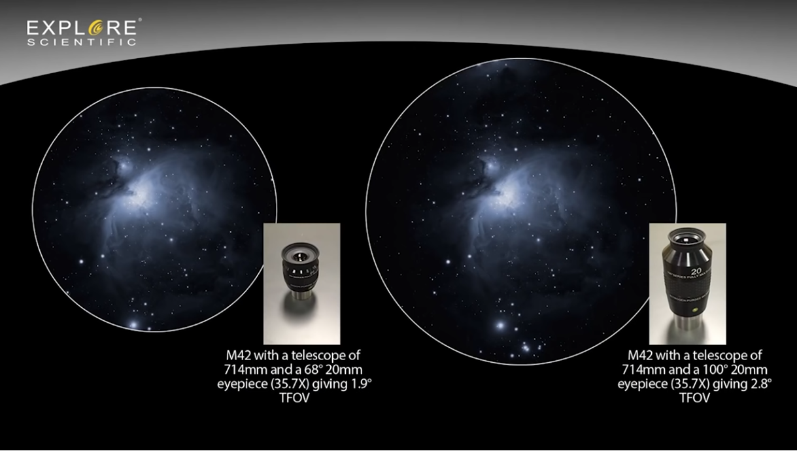

Slide 16
Calculating TFOV
TFOV Formula
TFOV = Eyepiece AFOV ÷ Magnification
Examples:
Ethos Ultra Widefield
17° = 100 ÷ 16 (Refractor)
1.4° = 100 ÷ 34 (Newtonian)
0.6° = 100 ÷ 48 (SCT)
Super Plössl
9.7° = 56 ÷ 16 (Refractor)
0.8° = 56 ÷ 34 (Newtonian)
0.4° = 56 ÷ 48 (SCT)

Slide 17
Eye Relief
Distance from the eyepieces rear most piece of glass to eye for optimum viewing.
Higher magnification normally means lower or less eye relief.
Longer eye relief means more comfort in viewing.
With eye relief of 17mm or more, the observer can wear glasses while observing.

Slide 19
Eyepiece Magnifiers or Barlows
Increase magnification
Increases focal length
Maintains eye relief
Adds some distortion because of additional optical elements.

Slide 20
Eyepiece Diameter
0.96 inches (department store or toy telescopes)
1.25 inches
2 inches
3 inches (professional or research grade)
With an eyepiece fl below 14mm a 2” provides little or no benefit.
With an eyepiece fl 14mm and above, 1.25” eyepiece may be losing some available light.
It depends on the AFOV of the eyepiece.

Slide 21
Coatings and Edge Blacking
Coatings increase light transmission and reduce reflections.
Coated - means at least one of the surfaces has a coating. Usually the one closest to your eye.
Multi-coated – means multiple surfaces have a coating. Usually the one closest to your eye and the one furthest away.
Fully Multi-coated – All glass surfaces are coated.
Better eyepieces have the edges blackened to prevent reflections.
Ar and N purged – Eyepieces are assembled in a Ar or N environment to prevent humidity, dew or water in the eyepiece.

Slide 22
What’s inside an Eyepiece

Slide 24
Eyepiece characteristics
Number of lens elements: typically, more lenses in an eyepiece mean sharper images, and/or a wider field of view, and/or longer eye relief . . . although sometimes with a loss of contrast compared to simpler eyepieces.
Sharpness: how well the eyepiece concentrates the light of a star into a point at the center of the field; how crisply defined lunar and planetary details appear; how cleanly binary stars are split.
Astigmatism: an aberration that turns stars into fuzzy oblongs instead of points, particularly towards the edge of the field. The oblongs point towards the center of the eyepiece field on one side of focus, but are at right angles to the center on the other side of focus. Not to be confused with field curvature, below.
Color correction: how free an eyepiece is from colored halos around stars at the edge of the field, false color in planetary images, or stars that change color as they move from the center to the edges of the field.
Ghosting: a flare of unwanted light around bright objects, or faint multiple images of bright objects, due to internal eyepiece reflections.
Field curvature: an inability to bring the center and edge of the field into focus at the same time, with the edge out of focus with the stars bloated when the center is sharply focused and vice-versa. Not to be confused with astigmatism, above, in which the stars change into ovals at the edge of the field.
Distortion: unequal magnification across the eyepiece field, so that straight lines appear curved; it is barrel distortion if the centers of straight lines bow outwards, and pincushion distortion if the centers bow inwards; excessive distortion can produce an annoying"seeing through a goldfish bowl" effect when panning across a star field.
Contrast: the range from light to dark seen in an eyepiece; high contrast makes the shadows in the bottom of lunar craters black, aids in splitting close binary stars,enhances subtle lunar and planetary detail, and helps ferret out small and faint planetary nebulas against a truly dark sky background; low contrast (due to internal reflections within the eyepiece lenses caused by unblackened lens edges and lesser-quality anti-reflection coatings) shows lunar crater shadows in shades of gray, rather than stark black, and makes subtle planetary and nebula detail more difficult to see.

Slide 25
Aberrations
Optical aberrations, often mistakenly called distortions, limit the performance of an eyepiece. Generally, the lower the f/number of the telescope, the greater the optical complexity of the eyepiece needed to produce good images. Simple two-element Huygens and Ramsden eyepieces with apparent fields of up to about 40° work quite nicely with high f/number telescopes, but a two-element design cannot be adequately corrected for fields greater than 40° or for low f/ratios.
You cannot judge an eyepiece by its name alone. Some orthoscopic eyepieces have a cemented triplet and a single eye lens, while others have two cemented doublets and might just as well be called Plössls. Even Plössls vary in design details from one to another. It is wise to check out an eyepiece before buying it, or at least seek the advice of others (perhaps astronomy club members) who have used them.
The following is a list of common problems with eyepieces.
Spherical aberration causes a softness of the image in the center of the field. It is not usually a problem with eyepieces that have three or more elements unless used with very fast objectives.
Axial color is the appearance of color fringes around an object at the center of the field. It is rarely a problem with designs using three or more elements, and it is absent from some two-element eyepieces.
Lateral color is seen as color fringes around objects near the edge of the field. This is difficult to "design out" of an eyepiece and can arise from poor manufacturing as well. This aberration may persist even when the eyepiece is used with objectives of high f/number.
Coma causes comet-shaped instead of round star images near the edge of the field. It is not usually encountered in good designs.
Astigmatism causes stars to appear as lines, crosses, or squares at the edge of the field. It is the most significant problem with wide-angle eyepieces, especially with low-f/number telescopes. Using a Barlow lens with the eyepiece will often suppress astigmatism dramatically.
Field curvature prevents an image from being in focus at the center and edge of the field simultaneously.
Distortion in an eyepiece makes straight objects look curved. While some eyepieces, especially orthoscopics, are better than others in this regard, distortion is not usually a problem in astronomical viewing. Pincushion or Barrel distortion.

Slide 26
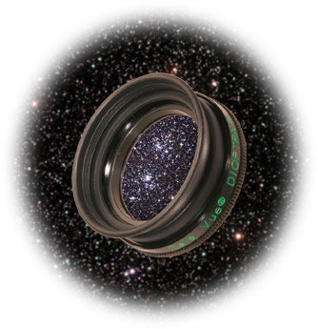
Astigmatism
Benefits of using Dioptrx over eyeglasses
1. You're more likely to see a sharper, higher contrast image, because:
A. The Dioptrx is always completely aligned to the eyepiece optics, eliminating aberrations from a decentered mismatch of eyeglass power and astigmatic axis.
B. Dioptrx can be rotated to exactly compensate for the astigmatic axis angle in real time, since both head angle and age can vary your eyesight astigmatic angle.
C. Dioptrx likely has better multi-coatings than eyeglasses, and certainly is better in transmission and reflection reduction than uncoated eyeglass.
D. Dioptrx is more likely to be cleaner than eyeglasses, which may have scratches and smudges from constant use and wear and tear.
E. Dioptrx allows seeing your normal maximum contrast that eyeglasses can diminish (remove your eyeglasses and see how contrast improves in normal vision).
2. You're more likely to see the full field in 100° Ethos eyepieces because your eyeglasses are more limiting in "effective eye-relief".
Got astigmatism? Get the "cure".
Your telescope's focuser is used to compensate for your near- or far-sightedness; DIOPTRX™ compensates for your astigmatism. These units attach and lock onto the tops of over 20 long eye-relief Tele Vue eyepieces to achieve the sharpest full-field viewing possible. DIOPTRX™ models are available in ¼ to 3½ diopter (¼ steps from ¼ to 2½ diopters, then ½ diopter steps to 3½-diopters), and are rotatable for tuning to the best orientation. A series of engraved letters on the barrel helps to monitor orientation. Simply choose the DIOPTRX™ model that matches your eyeglass prescription for astigmatism. All lenses are multi-coated glass in anodized aluminum housings with rubber eyeguards.
DIOPTRX™ |  | TeleVue.com: Eyepiece Accessories > DIOPTRX™ > Home

Slide 27
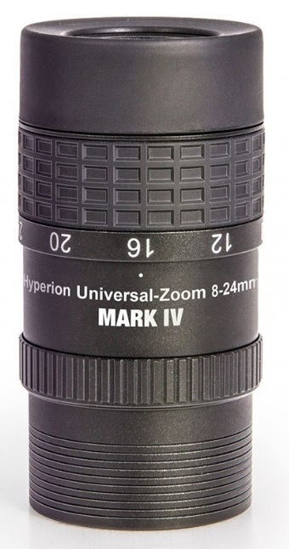
Zoom Eyepiece
Ability to change magnification without changing the eyepiece.
Not parfocal, you need to refocus at different magnification.
AFOV changes when you zoom in/out.
This is the rough AFOV for the Baader Hyperion zoom. 24mm = AFOV 42° 20mm = AFOV 49° 16mm = AFOV 52° 12mm = AFOV 58° 8mm = AFOV 70°

Slide 28
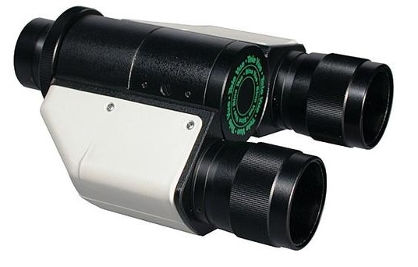
BinoViewer
ADVANTAGES... 1) More comfortable and natural observing 2) Shows more detail (your brain works better with two eyes)
DISADVANTAGES... 1) You have to buy double your eyepieces 2) Most scopes need to use optional OCA/GPC so in effect acts like a Barlow and can't get as wide of a TFOV 3) Heavy so sometimes balance or weight issues 4) Some binoviewers vignette if using 32 Plossls or 24 Panoptics, and the like 5) Using 2" eyepieces impossible except for a very few expensive binoviewers 6) Not all eyepieces can work due to their housing width and the distance between your eyes (IPD). 7) Like a Barlow, complicates rather than simplifies the observing process.

Slide 29
Common Filters
Broadband or Notch – General Light Pollution
Deepsky
Skyglow
LPR – Light Pollution Reduction
Narrowband Nebula
NPB
UHC – Ultra High Contrast
Ultrablock
Line Nebula
O-III – Oxygen 3
Ha – Hydrogen alpha
Hb – Hydrogen beta
S-II – Sulfur-2
Moon or Polarized

Slide 30
Filter Myths

Slide 31
Filter Types

Slide 32
Making Filters Work

Slide 33
Formulas
F-ratio = focal length ÷ aperture(mm)
Magnification = Telescope focal length(mm) ÷ Eyepiece focal length(mm)
Exit pupil = Eyepiece focal length(mm) ÷ Telescope f-ratio
LUM = Telescope Aperture(mm) ÷ Fully dilated eye(mm)
Lowest Useful Magnification Eyepiece fl(mm) = Telescope fl(mm) ÷ LUM
HUM = Telescope Aperture(inches) x 40 (60 under pristine skies)
TFOV = Eyepiece AFOV ÷ Magnification

