Slide 1
Are We Alone?

Slide 2
Think about it for a minute…
How many galaxies are there out there?
How many stars in every galaxy?
How many planets around the stars?
How many are habitable?
How many have life forms?
How many have intelligent life forms that can communicate?
What are the odds of us communicating with them?

Slide 3
Did you ever wonder, is there life out there?

Slide 4
So what are your thoughts?
There is no right or wrong answer.
If we are the only intelligent life form in the universe it would be totally amazing.
Even more amazing would be if there are other intelligent life forms.
But we do have a way to predict this and if we will communicate with them.
The Drake Equation.

Slide 5
Frank Drake had a problem. It was the fall of 1961, a year after his pioneering SETI experiment: Project Ozma. Using an 85-foot antenna in Green Bank, West Virginia, Drake had unfurled the intriguing possibility that we might find proof of intelligent beings by simply eavesdropping on their broadcasts. He had spent several weeks pointing his antenna at two nearby stars, tuning a simple receiver to 1420 MH, hoping to detect transmissions.
The interest generated by Project Ozma was considerable, and so Drake was asked to organize a conference in Green Bank to weigh the possibility of actually detecting the aliens. He decided to invite about a dozen scientists and technologists, and knew that the discussions would range from the astronomical (how many good planets are out there?) to the sociological (how long might a technical civilization survive?)
But he needed an agenda, and there was no precedent to turn to. That’s when Drake came up with a simple equation, a string of seven factors that, when multiplied together, provide an estimate of the number of galactic, transmitting societies. If this number was very small, then SETI made no sense. If it was large, then there was a chance of hearing something. This equation solved his agenda problem.
No “official” estimates for the terms of Drake’s equation were produced by the conference, although Drake himself has suggested that the number of galactic societies that are on the air might be ten thousand. But despite the fact that his formulation is hard to evaluate (we still don’t know the values of many terms), it has become a widely accepted tool for considering the question of extraterrestrial intelligence.
Indeed, 55 years after Frank Drake first wrote this equation on a chalkboard, it has arguably attained the status of the second most famous formula in science (after Einstein’s E=mc2), and can be found in every astronomy textbook. It is also a guide for the research programs of the SETI Institute, each of which can be tied to a term in the equation.
Drake may have not found the aliens, but he found an intellectual path to their discovery.

Slide 7
The Drake Equation
N = R* x fp x ne x fl x fi x fc x L
where:
N = the number of civilizations in our galaxy with which communication might be possible (i.e. which are on our current past light cone);
and
R* = the average rate of star formation in our galaxy
fp = the fraction of those stars that have planets
ne = the average number of planets that can potentially support life per star that has planets
fl = the fraction of planets that could support life that actually develop life at some point
fi = the fraction of planets with life that actually go on to develop intelligent life (civilizations)
fc = the fraction of civilizations that develop a technology that releases detectable signs of their existence into space
L = the length of time for which such civilizations release detectable signals into space

Slide 8
N = R* x fp x ne x fl x fi x fc x L
R* = the average rate of star formation in our galaxy.
For the Milky Way it’s 6 stars per year.

Slide 9
N = 6 x fp x ne x fl x fi x fc x L
fp = the fraction of those stars that have planets.
1 out of 2, so 50%
We know it’s probably higher, but we will play it safe and go low.

Slide 10
N = 6 x .5 x ne x fl x fi x fc x L
ne = the average number of planets that can potentially support life per star that has planets.
Approximately 2.
These would be planets in the habitable or goldilocks zone.

Slide 11
N = 6 x .5 x 2 x fl x fi x fc x L
fl = the fraction of planets that could support life that actually develop life at some point.
1 out of 100.

Slide 12
N = 6 x .5 x 2 x .01 x fi x fc x L
fi = the fraction of planets with life that actually go on to develop intelligent life (civilizations).
1 out of 100.
What is intelligent life?
Insects, birds, dinosaurs, fish, snakes, rodents, whales, dolphins, apes?

Slide 13
N = 6 x .5 x 2 x .01 x .01 x fc x L
fc = the fraction of civilizations that develop a technology that releases detectable signs of their existence into space.
1 out of 100.

Slide 14
N = 6 x .5 x 2 x .01 x .01 x .01 x L
L = the length of time for which such civilizations release detectable signals into space.
Lifetime of a civilization in years = 5000 (humans), 170,000,000 (dinosaurs).
Something to think about: Earth has been a bright electromagnetic source in the sky since around 1900 when radio started transmitting. But over the last few decades we are becoming a much dimmer electromagnetic source. Low power digital transmissions of TV and Radio stations and low power data to/from Satellites. We are moving to other low power transmissions like cell phones, WiFi, Bluetooth and Fiber Optics. If other civilizations move to low power, the odd's of hearing them goes down too.

Slide 15
N = 6 x .5 x 2 x .01 x .01 x .01 x 5000
So now we have all our values.
N = 6 x .5 x 2 x .01 x .01 x .01 x 5000
N = 0.025% chance of us communicating with someone in the Milky Way.

Slide 16
So what are we doing to try and communicate?
Two main orginizations:
SETI = Search for Extraterrestrial Intelligence. (Mainly listen)
CETI = Communication with Extraterrestrial Intelligence. (Send Messages and listen)

Slide 17
Send Messages to Who?
The Arecibo Radio telescope was used to send a message to M13 the Hercules cluster.
It’s only 25,000 LYR’s away.
So we may have an answer back in 50,000 years.
What kind of message?
A mathematical message.

Slide 18
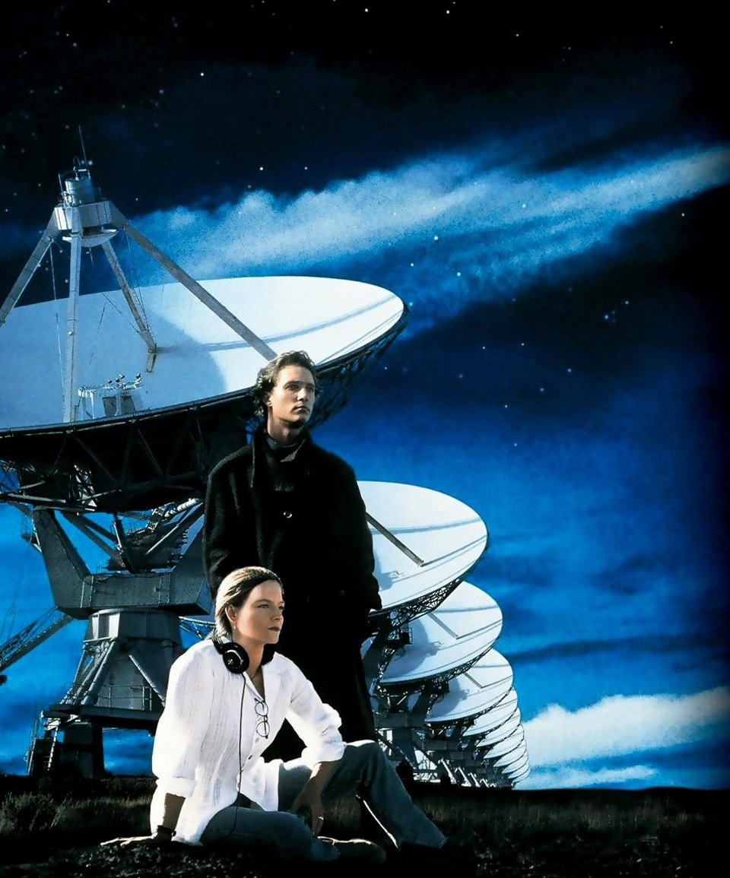

Slide 19
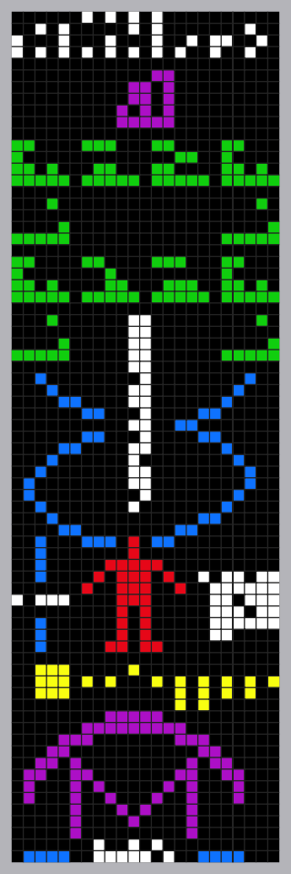
The Arecibo message was a short radio message sent into space to celebrate the remodeling of the Arecibo radio telescope in Puerto Rico in 1974. It was aimed at the globular star cluster M13, about 25,000 light years from Earth. M13 was chosen because it was the right size, and was in the sky at the right time and place for the ceremony.
Dr. Frank Drake, then at Cornell University and creator of the famous Drake equation, wrote the message, with help from Carl Sagan, among others. The message was in seven parts which show:
The numbers one (1) to ten (10)
The atomic numbers of the elements hydrogen, carbon, nitrogen, oxygen, and phosphorus, which make up deoxyribonucleic acid (DNA)
The formulas for the sugars and bases in the nucleotides of DNA
The number of nucleotides in DNA, and a graphic of the double helix structure of DNA
A figure of a human, the size of an average man, and the human population of Earth
The Solar System
The Arecibo Observatory and the diameter of the transmitting antenna dish
It will take 25,000 years for the message to reach the stars, and at least another 25,000 years to get any reply. This means the Arecibo message was a show of human technological achievement, not a real attempt to talk to extraterrestrial life. The stars of M13 that the message was aimed at will no longer be in that location when the message arrives. Cornell University said on November 12, 1999, the real purpose of the message was not to make contact, but to show the power of the new equipment. (Cornell University had built and operated the radio telescope for the United States National Science Foundation.)
The message consisted of 1679 binary digits, about 210 bytes. It was transmitted at a frequency of 2380 MHz and modulated by shifting the frequency by 10 Hz, with a power of 1000 kW. The "ones" and "zeros" were transmitted by frequency shifting at the rate of 10 bits per second. The total broadcast was less than three minutes.
The cardinality of 1679 was chosen because it is a semiprime. It can be arranged as a rectangle of 73 rows by 23 columns. The other arrangement, 23 rows by 73 columns, does not produce a meaningful result. The message forms the image shown on the right, or its inverse, when translated into graphics characters and spaces.

Slide 21
June 18, 2019 – Breakthrough Listen – the astronomical program searching for signs of intelligent life in the Universe – has submitted two publications to leading astrophysics journals, describing the analysis of its first three years of radio observations and the availability of a petabyte of radio and optical telescope data. This represents the largest release of SETI data in the history of its field.
They have release over a petabyte of data and made it available to the public.

Slide 22
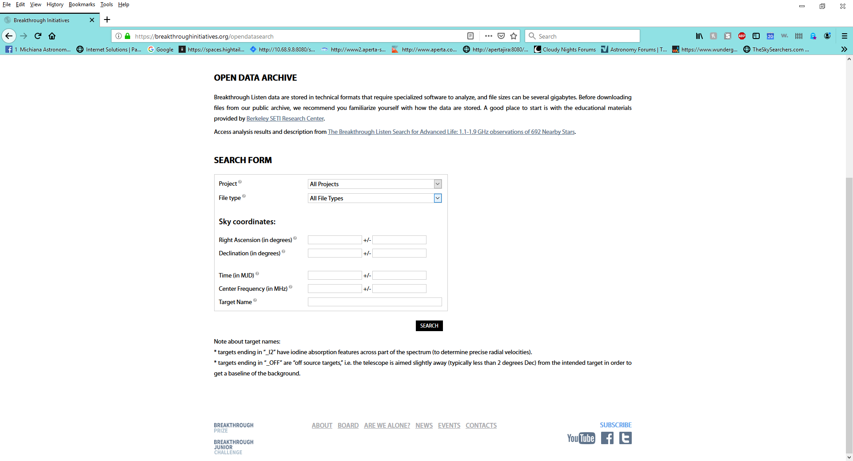

Slide 23
https://www.space.com/ufos-real-but-not-alien-spaceships.html?jwsource=cl
https://www.youtube.com/watch?v=Qpk66GvvGGU
https://breakthroughinitiatives.org/
https://breakthroughinitiatives.org/opendatasearch

